Slide 1

JSS College Of Arts Commerce And Science Ooty Road ,MYSURU.
MENTOR MENTEE MANAGEMENT SYSTEM
SUBMITTED TO:
KAVYASHREE D G
ASST.PROFESSOR
DEPARTMENT OF COMPUTER APPLICATION
JSSCACS,MYSORE.
SUBMITTED BY:
AMRUTHA B M

Slide 2
AIM OF THE PROJECT
The aim of a Mentor mentee management system
is to enhance agriculture productivity and sustainability by guiding formers in selecting the optimal crops for their specific conditions. Key objectives include maximizing crop yield through the selection of varieties best suited to the local soil, climate, and water availability by considering these environment factors, the system helps in achieving higher productivity and better quality produce.

Slide 3
Table
SL.NO | Chapter Name | Page no
01 | Introduction | 1
01 | System study | 2
02 | Literature Survey | 6
03 | Software requirement specification | 7
04 | System Design | 18
05 | Modules | 22
06 | System Testing | 28
07 | Snapshots | 31
08 | Conclusion | 41
09 | Future enhancement | 44
10 | Bibliography | 45

Slide 4
ABSTRACT
Crop Recommendation System for agriculture is based on various input parameters. This proposes a hybrid model for recommending crops to south Indian states by considering various attributes such as soil type, Rainfall, Groundwater level, Temperature, Fertilizers, Pesticides and season. The recommender model is built as a hybrid model using the classifier machine learning algorithm. Based on the appropriate parameters, the system will recommend the crop. Technology based crop recommendation system for agriculture helps the farmers to increase the crop yield by recommending a suitable crop for their land with the help of geographic and the climatic parameters.

Slide 5
HARDWARE REQUIREMENTS PROCESSER : PENTIUM IV /ABOVE
SOFTWARE REQUIRMENT
SERVER : PYTHON
FONT END : HTML 5.0 CSSS 3.0 BOOTSTRAP 4.0
TIER : PYTHON
DATABASE : MYSQL [included in XAMPP]
BROWSER : Google Chrome, Mozilla Firefox operating
SYSTEM : Windows 8.0 and above

Slide 6
INTRODUCTION
In the world of developing technologies, the success of sharing information will help the agriculturists in realizing and developing their potential. The information sharing is that the valuable and timely information is being shared between agriculturists, either formally or informally. Data set collection from various sources. Data parsing and cleansing technique is applied to make the raw data into processing data. The data collected is subject to machine learning system along with run time analysis makes an efficient crop value updation system. Usage of Ensemble of classifiers makes the model more robust and efficient.

Slide 7
Existing system
The existing systems for crop recommendation typically rely on various data-driven approaches to suggest suitable crops for farmers based on factors such as soil type, climate conditions, historical data, and sometimes socioeconomic factors. Here are some common components and methods used in these systems:
Data Collection:
Soil Data: Information about soil quality, pH levels, nutrient content, etc., collected through soil testing.
Climate Data: Historical weather patterns, rainfall data, temperature variations, and other climatic factors.
Crop Data: Historical crop yields, growth patterns, and success rates in specific regions.

Slide 8
Disadvantage of existing system
Data Dependency: These systems heavily rely on accurate and up-to-date data related to soil quality, weather patterns, historical yields, etc.
Complexity and Expertise: Implementing and maintaining these systems often requires expertise in data science, agronomy, and technology.
Cost of Implementation: Setting up these systems, including acquiring necessary sensors, software licenses, and infrastructure, can be costly.
Limited Scope: Existing systems may not consider all factors influencing crop growth, such as local pest outbreaks, socio-economic factors, or farmer preferences.

Slide 9
Proposed system
In proposed system, the data analysis technology is used to update the crop yield rate change. The concept of this paper is to implement the crop selection method so that this method helps in solving many agriculture and farmers problems. This improves our Indian economy by maximizing the yield rate of crop production. Different types of land condition. So, the quality of the crops are identified using ranking process. By this process the rate of the low quality and high-quality crop is also intimated. The usage of ensemble of classifiers paves a path way to make a better decision on predictions due to the usage of multiple classifiers. Further, a ranking process is applied for decision making in order to select the classifiers results.

Slide 10
advantages
Personalization: Advanced machine learning techniques can provide more personalized recommendations by considering a wider range of factors specific to each farmer's field, such as soil health, microclimate variations, and historical crop performance.
Real-time Adaptability: Utilizing IoT devices and real-time data feeds allows the system to adapt recommendations dynamically based on current weather conditions, soil moisture levels, and other relevant parameters.
Improved Accuracy: By leveraging more sophisticated algorithms and larger datasets, the proposed system can potentially offer more accurate predictions of crop suitability and expected yields.
Enhanced Sustainability: Recommendations can incorporate sustainability criteria, such as promoting crop rotations that improve soil health, reducing water consumption, or minimizing pesticide use, thus promoting more sustainable agricultural practices.

Slide 11
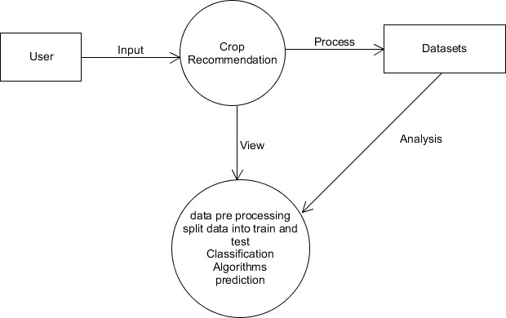
Data flow diagram
The DFD also provides information about the output and inputs of each entity and the process itself. A data flow diagram has no control flow, there are no decision rules and no loops.

Slide 12
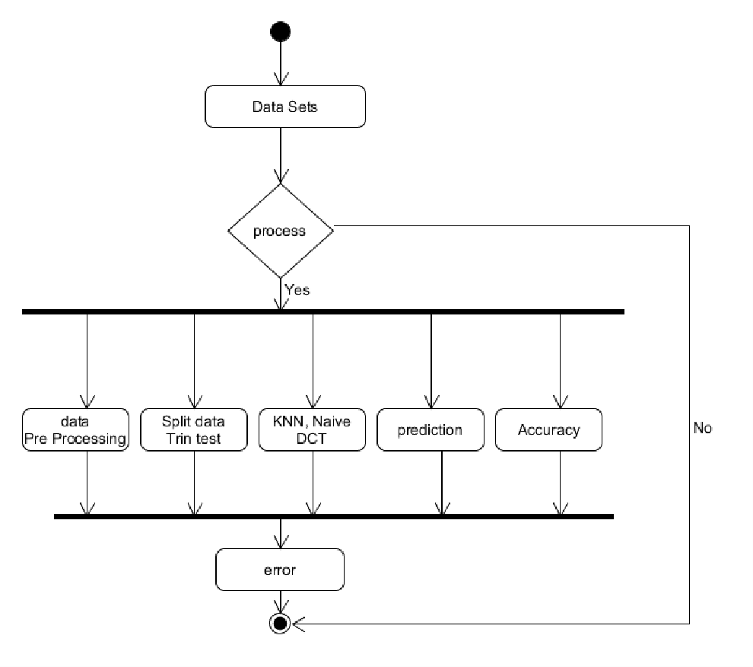
Process flow diagram
An activity diagram visually presents a series of actions or flow of control in a system similar to a flowchart or a data flow diagram. Activity diagrams are often used in business process modelling.

Slide 13
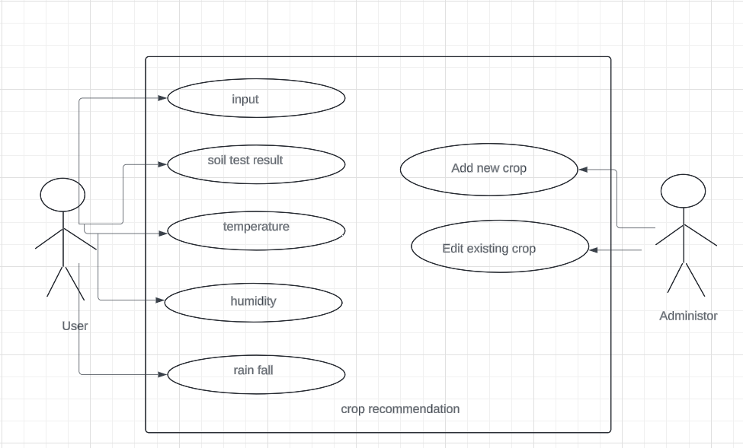
Use case diagram
In the Unified Modeling Language (UML), a use case diagram can summarize the details of your system's users (also known as actors) and their interactions with the system.

Slide 14
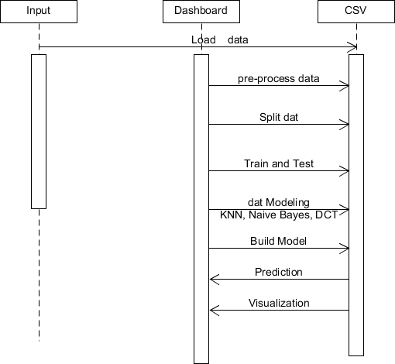
SEQUENCE diagram

Slide 15
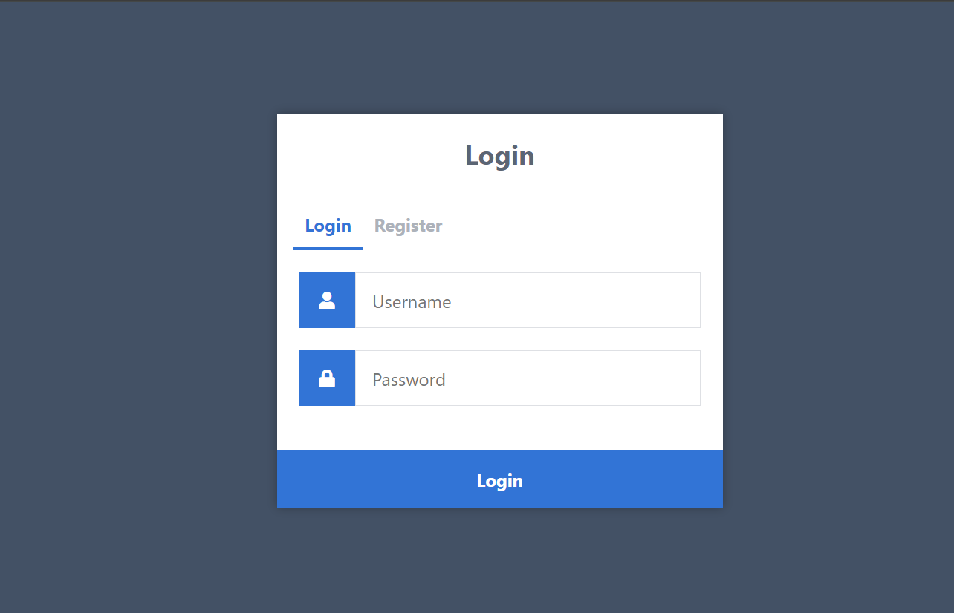
snapshots
LOGIN

Slide 16
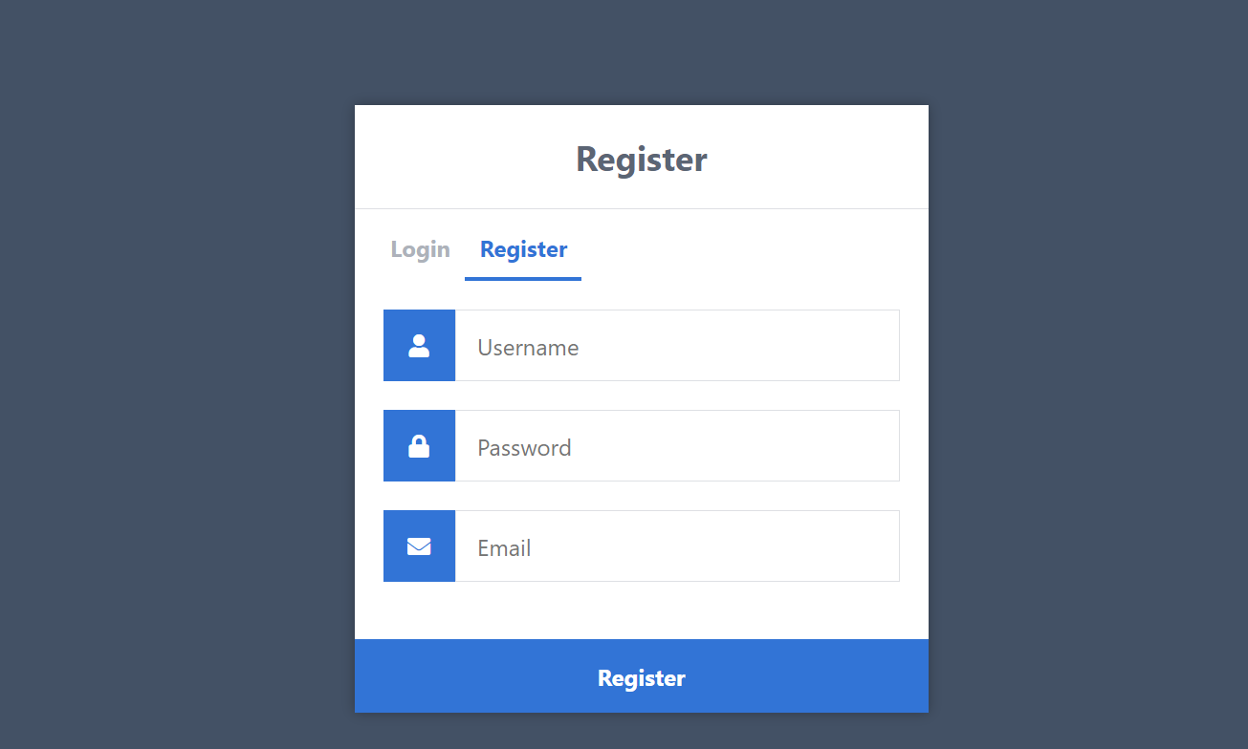
REGISTER

Slide 17
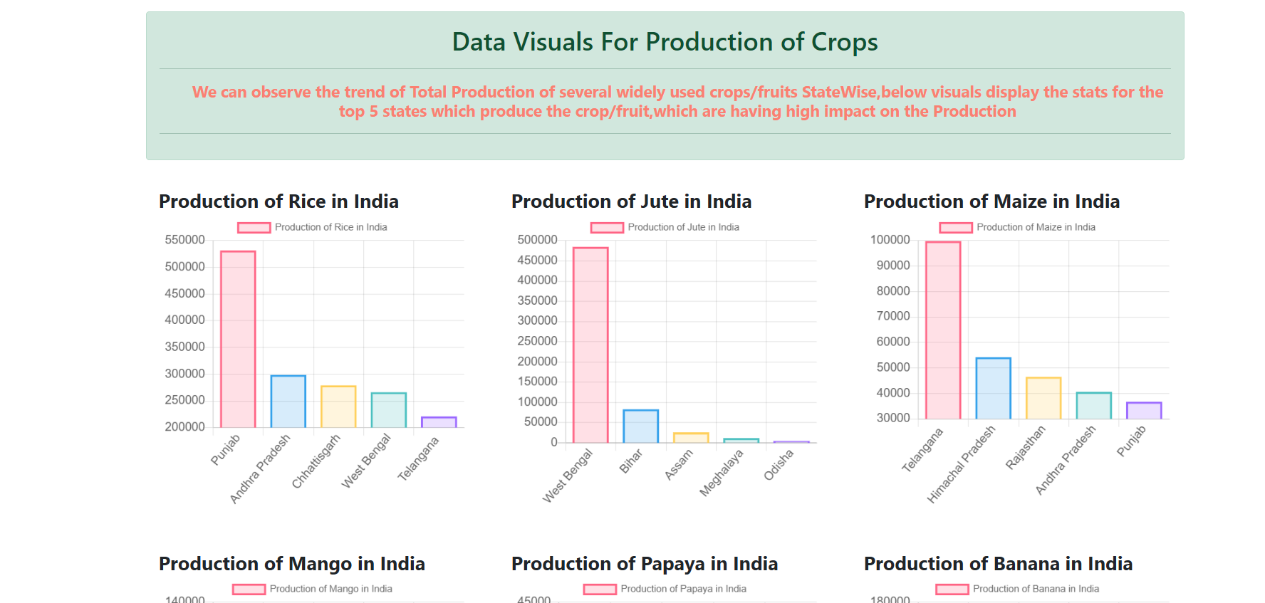
DASHBOARD

Slide 18
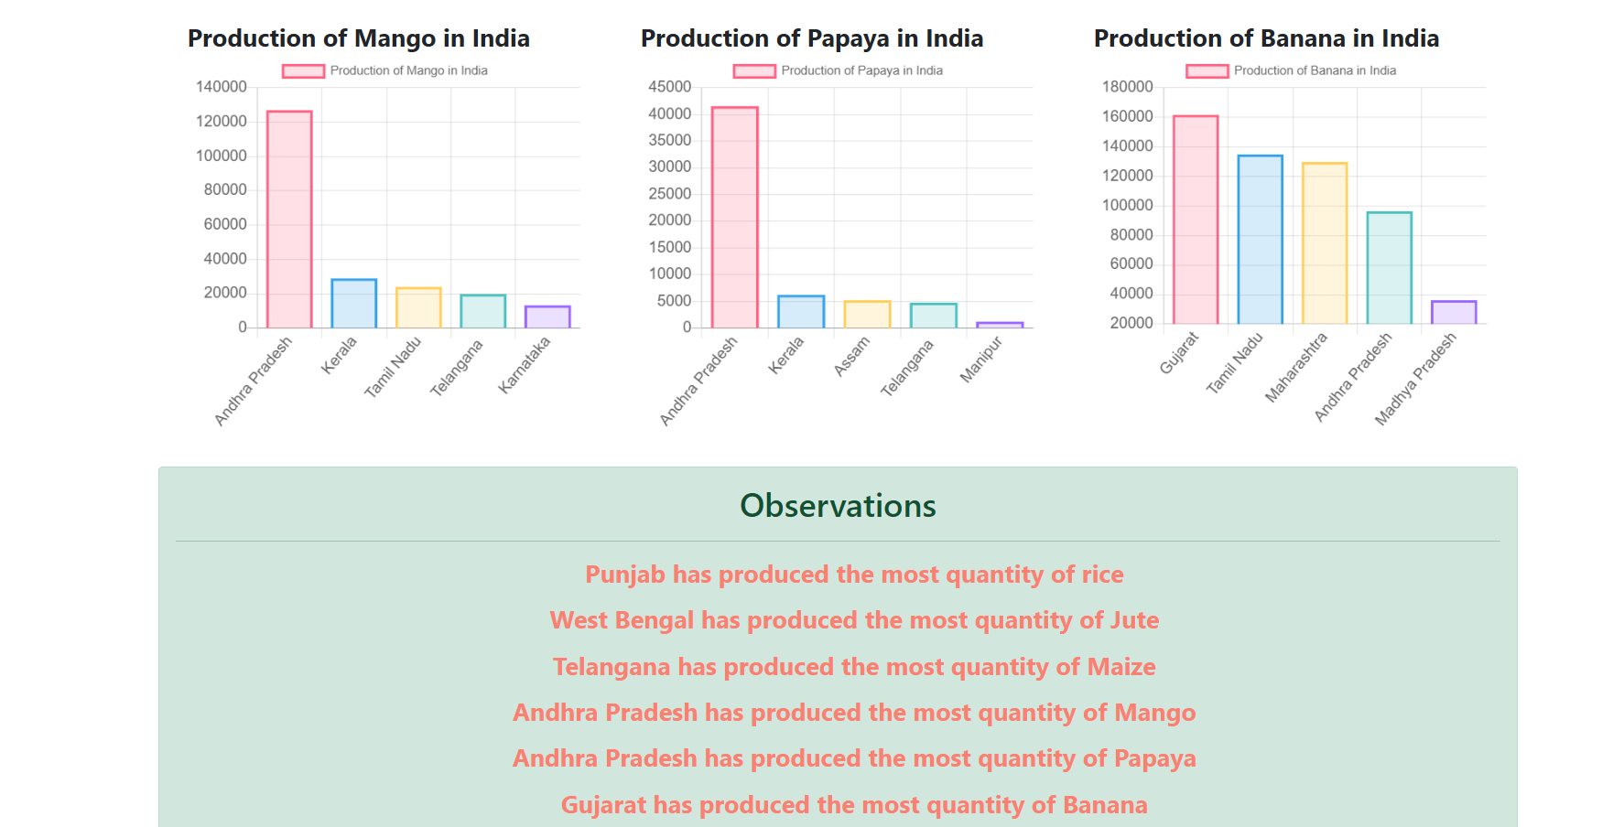
ADD CATEGORES/LIST

Slide 19
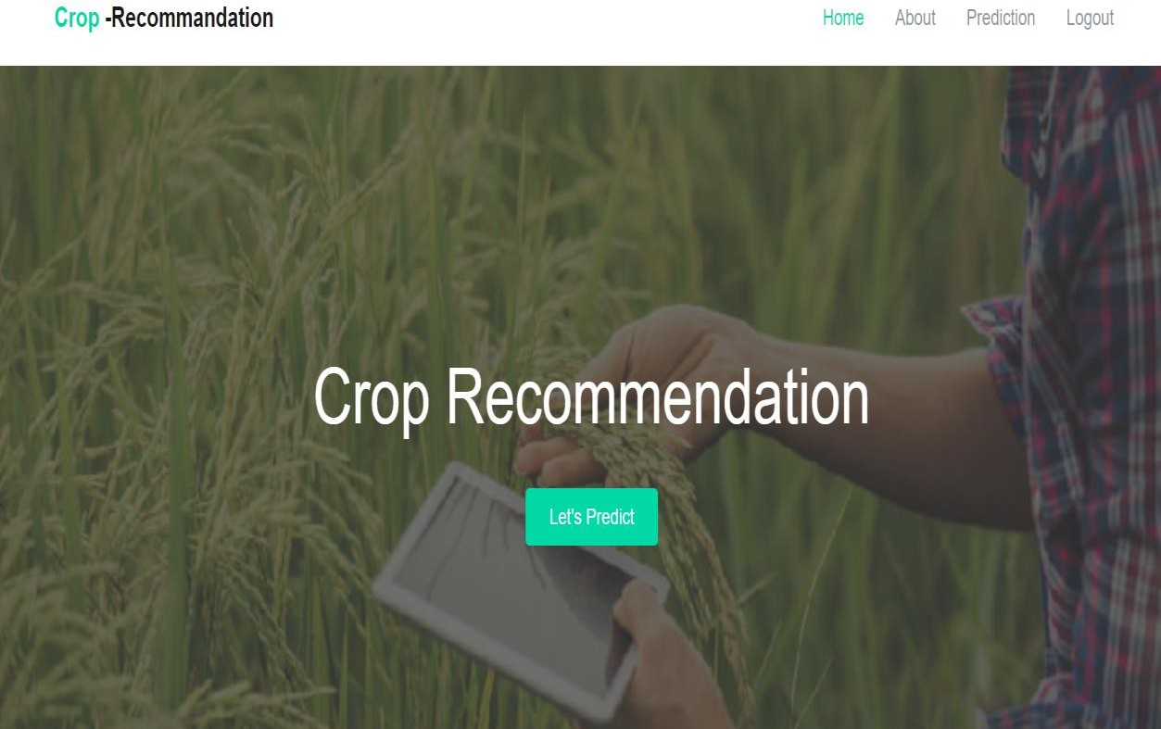
HOME PAGE

Slide 20
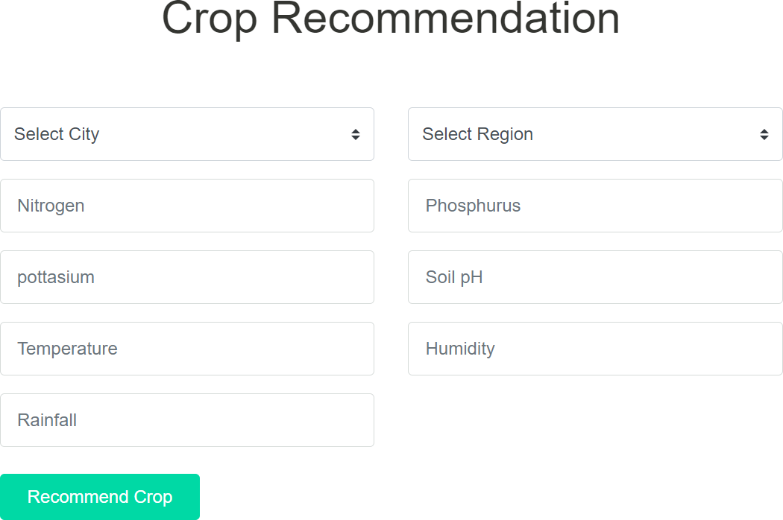
CROP RECOMMENDATION

Slide 21
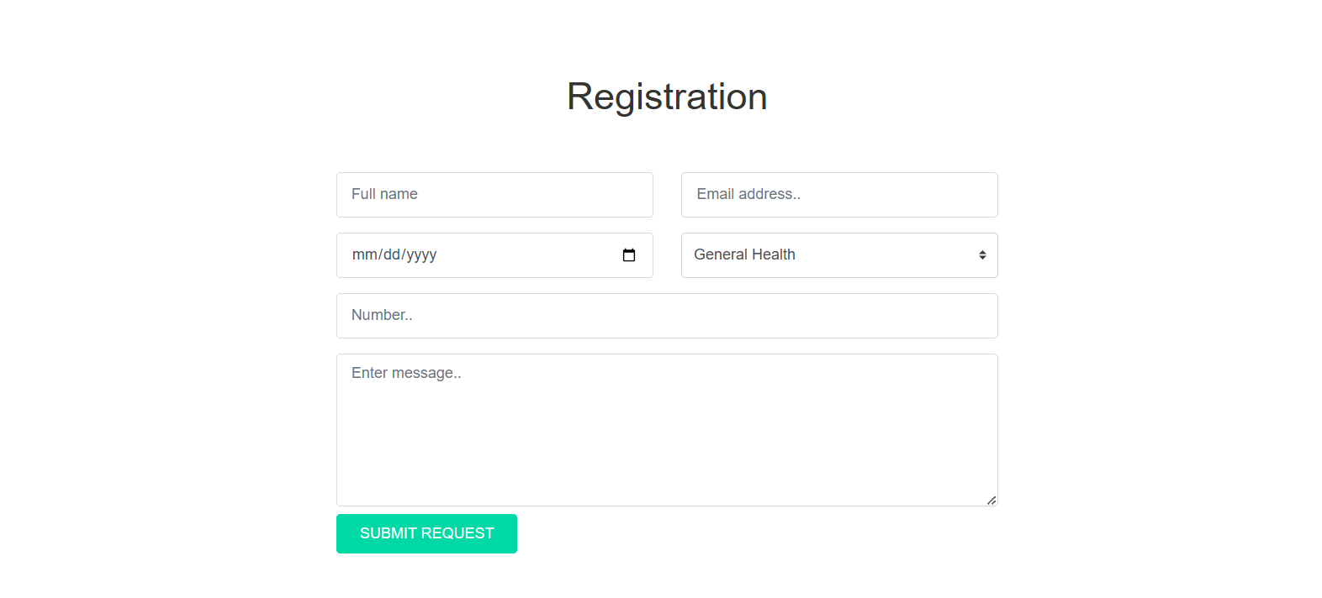
REGISTRATION

Slide 22

REGISTRATION SUCCESSFULLY

Slide 23
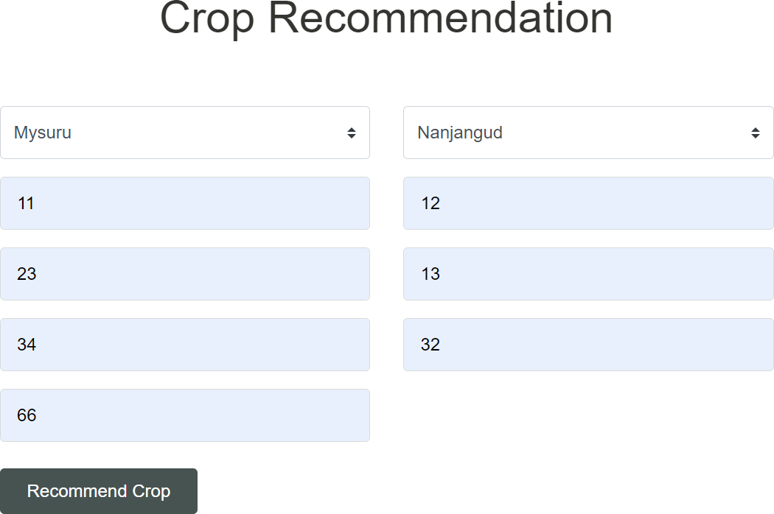
CROP RECOMMENDATION

Slide 24
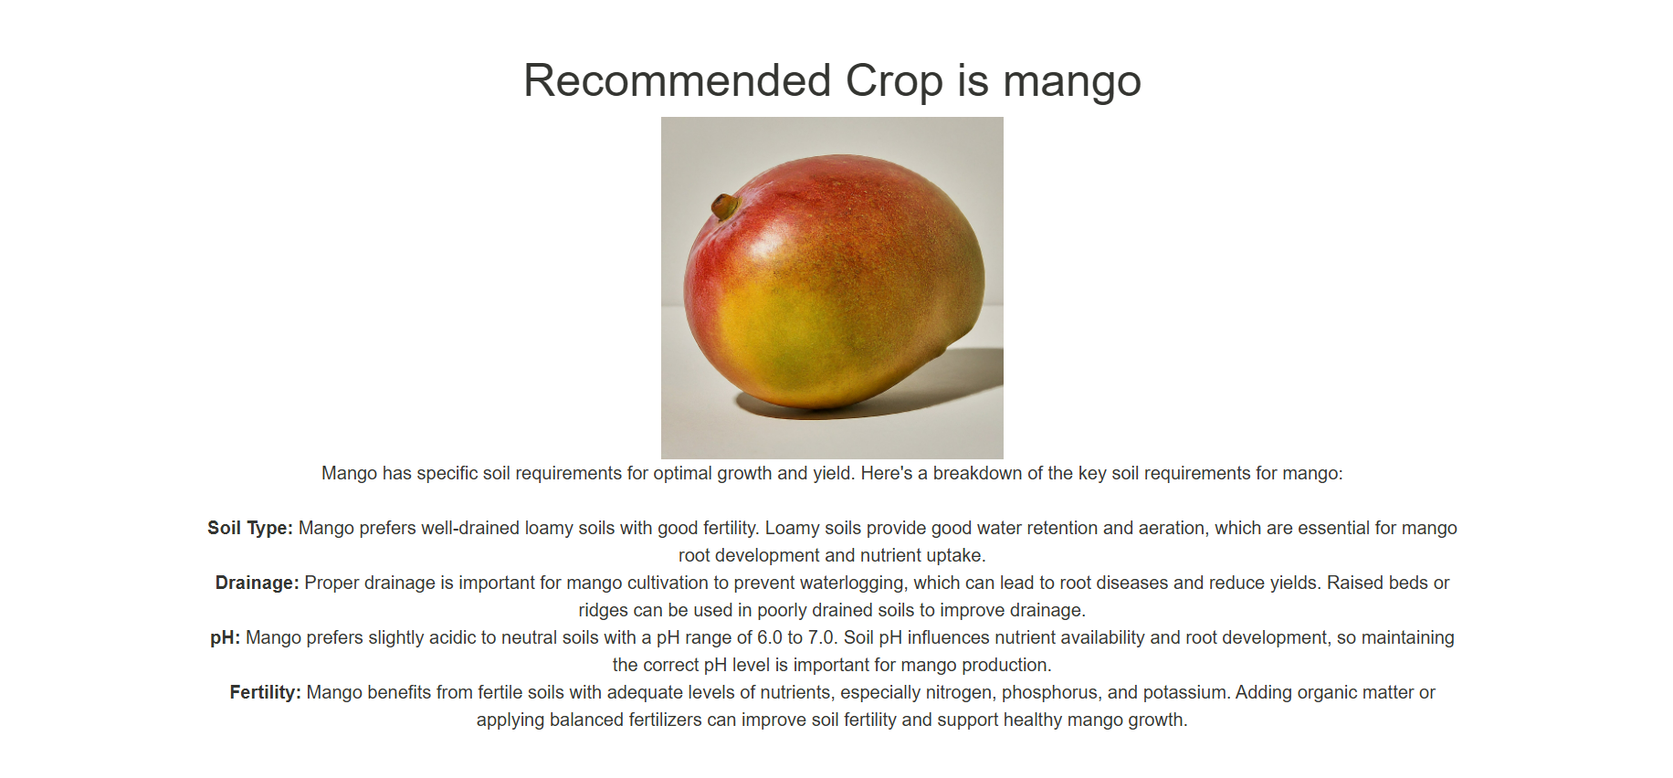
OUT PUT

Slide 25
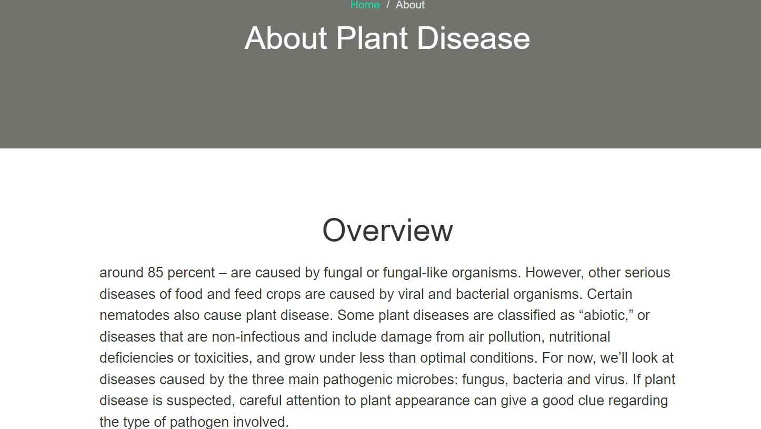

Slide 26
conclusion
The system is divided into distinct modules, each with clear responsibilities, facilitating easy development, testing, and maintenance.
This modularity ensures the system can be scaled up or adapted to incorporate new data sources, machine learning techniques, and functionalities as technology and agricultural practices evolve.
By integrating diverse data sources such as soil characteristics, climate conditions, and market trends, the system provides data-driven insights that help farmers make informed crop choices.
The system's reliance on accurate and comprehensive data collection ensures the recommendations are relevant and context-specific, tailored to the unique conditions of each farm.
The incorporation of machine learning models, including classification and regression algorithms, enables the system to predict the best-suited crops and estimate potential yields and economic returns.

Slide 27
FUTURE ENHANCEMENT
AI and Machine Learning: Enhanced algorithms for better prediction of crop suitability based on historical data, weather patterns, and soil health.
Big Data Integration: Utilizing big data analytics to process large volumes of agricultural data for more precise recommendations.
Remote Sensing and IoT: Integration of satellite imagery, drones, and IoT sensors to gather real-time data on crop conditions and environmental factors.
Precision Agriculture: Implementing precision farming techniques to tailor recommendations at a micro-level, optimizing resource use and minimizing environmental impact.

Slide 28
Thank YOU

